Slide 1

For Dates of Service 1/1/19 through 3/31/19
Information for Providers

Slide 2
Who is Allegiance?
Our History
Originally founded in 1980, Allegiance has administered Self-Funded Health Plans for more than three decades.
Over 150 clients across the country representing more than 400,000 lives.
Clients include hospital systems, school districts and government organizations, insurance trusts, and MEWAs.
Claims processing, customer service, enrollment, and all other services are coordinated from our corporate office in Missoula, MT.
Allegiance became a wholly-owned subsidiary of Cigna in 2008 enabling us to offer the flexibility and customized service of our TPA model alongside Cigna’s extensive network and analytic products.

Slide 3

Allegiance, Teachers Health Trust and WellHealth
Our Relationship
Effective January 1st 2019, Allegiance will be the third party administrator (TPA) for the Teachers Health Trust in Las Vegas.
WellHealth will continue to be the provider network utilized for the members under the plan.

Slide 4
Working with par8o
Referral Management System

Slide 5
PCP and Referral Requirements to Specialists
Enhancements to the 2019 THT Benefits
Obstetricians, Gynecologists and Midwives as PCPs: THT is now allowing members to use their Ob/Gyn or Midwife as their PCP. This is a change from last year.
Use par8o System for Specialist Referrals: In order for members to receive the highest benefit and lowest office visit copay, PCPs will need to provide a referral to the appropriate specialist. The referral process is easily made—or received--using the par8o portal.
All PCPs Refer: For 2019, any WellHealth Community Medical Associates (WHCMA) contracted PCP can make a referral to a specialist. The PCP does not have to be the PCP the member elected during open enrollment.
Healthcare Advocates Refer New Patients Using par8o: Healthcare Advocates will now have the ability to refer new patients looking to establish with a PCP directly to network providers via the par8o system.

Slide 6
PCP and Referral Requirements to Specialists
Expanded Functionality and Usage of par8o
(Referral Management System)
Our network uses the par8o (the letter “o” not a zero) Referral Management System (RMS) to track referrals sent between network providers, ensuring that patients are directed to the appropriate in-network resource and are seen within a reasonable amount of time.
In addition, the par8o system allows us to quickly identify those patients who may qualify for one of our programs targeting the management of chronic care conditions such as diabetes or COPD.
Provider Advocates are available to answer your questions
on how to use the par8o system.

Slide 7
PCP and Referral Requirements to Specialists
par8o Referral Portal Help
par8o is an intuitive system to use, however, tutorials are available to help you refer with ease!
Providers SENDING referrals can visit:
https://help.par8o.com/help/sending-referrals-mgm-and-teachers-health-trust
Providers RECEIVING referrals can visit:
https://help.par8o.com/help/you-received-a-referral-now-what
Provider Advocates are available to answer any questions you may have
on how to use the par8o system. Call them directly or
call Network Relations at (702) 304-5788.

Slide 8
Working with Allegiance

Slide 9
Working with Allegiance Care Management
Medical Pre-Certification / Pre-Treatment Review
Pre-certification and Pre-treatment Review for services will be coordinated through Allegiance Care Management (ACM), an Allegiance company.
Allegiance Care Management Nurse case managers and reviewers are available by phone at (800) 342-6510
To view the pre-treatment spreadsheet:
Go to the client specific web page: www.askallegiance.com/THT
Click on the For Providers tab
Once on the provider page, click on the Pre-Treatment Review/Pre-Certification link. On this page you will see Outpatient Pretreatment Review. This will be the page to search for whether a procedure needs to be reviewed.

Slide 10
Working with Allegiance
Submitting Claims
All medical claims for dates of service 1/1/2019 forward must be sent to:
Allegiance
PO Box 3018
Missoula, MT 59806
Payer ID: 81040
All 2018 dates of service and inquires follow the current process through THT.
Timely filing for WellHealth providers is 90 days from the date of service.

Slide 11

Working with Allegiance
Claims Processing/Payment
All claims will be processed by Allegiance
Checks and EOPs will come from Allegiance.
EFT/835 fulfilled by
(877) 828-8770 www.zelispayments.com

Slide 12
Working with Allegiance
Benefits & Questions
Online Verification of Benefits are available at: www.askallegiance.com/tht
Allegiance Customer Service – (855) 999-1050
Available from 5am-5pm Pacific, Monday through Friday
Automated Voice Response system (IVR) is also available 24/7/365 for claims and benefit information
270/271, 276/277 Transactions
Allegiance Payer ID: 81040

Slide 13
Working with Human Behavior Institute
Mental Health and Chemical Dependency Pre-Certification / Pre-Treatment Review
Pre-certification and Pre-treatment Review for Mental Health and Chemical Dependency services will be coordinated through Human Behavior Institute (HBI).
HBI reviewers are available by phone at (702) 248-8866 or (800) 441-4483

Slide 14
Working with Allegiance
Claims Processing/Payment Overview
Process | Contact | Add’l Information
Claim Submission – Medical | Allegiance | PO Box 3018 Missoula, MT 59806 Payer ID: 81040
Medical Pre-Certification / Pre-treatment Review | Allegiance Care Management | (800) 342-6510
Claim Refunds | Allegiance | PO Box 3018 Missoula, MT 59806 Payer ID: 81040
Customer Service/Claim Status/Claim Payment | Allegiance | (855) 999-1050 www.askallegiance.com/THT
Benefit Verification | Allegiance | (855) 999-1050 www.askallegiance.com/THT

Slide 15
Working with Allegiance
Claims Processing/Payment Overview
Process | Contact | Add’l Information
Mental Health and Chemical Dependency Pre-Certification / Pre-treatment Review | Human Behavior Institute (HBI) | (702) 248-8866 (800) 441-4483
Pharmacy Prior Authorization | MedImpact | 888) 648-6764
Vision Eligibility and Benefits | VSP | (800) 877-7195
270/271, 276/277 Transactions | Allegiance | Payer ID: 81040
EFT/835 | Zelis | (877) 828-8770 www.zelispayments.com

Slide 16
Additional Information

Slide 17
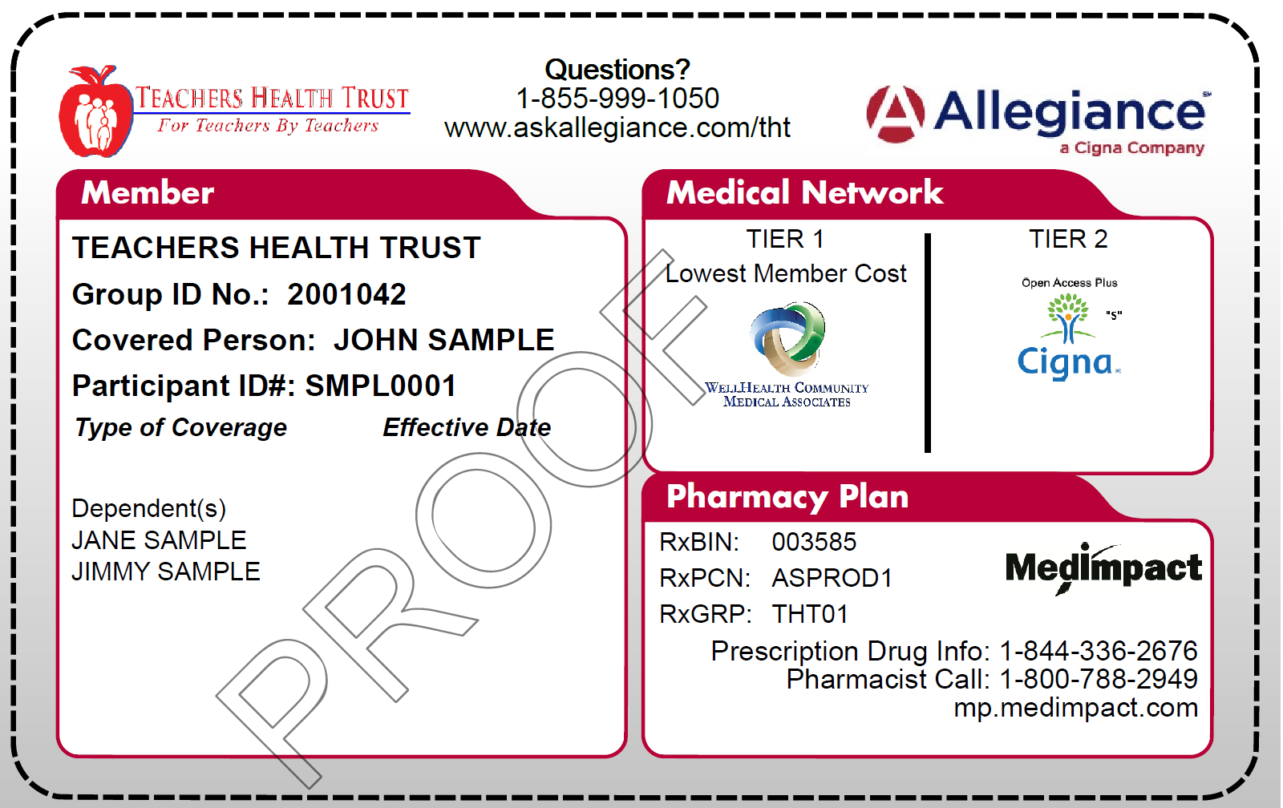
New Member Identification Cards
Sample ID Card (front)

Slide 18
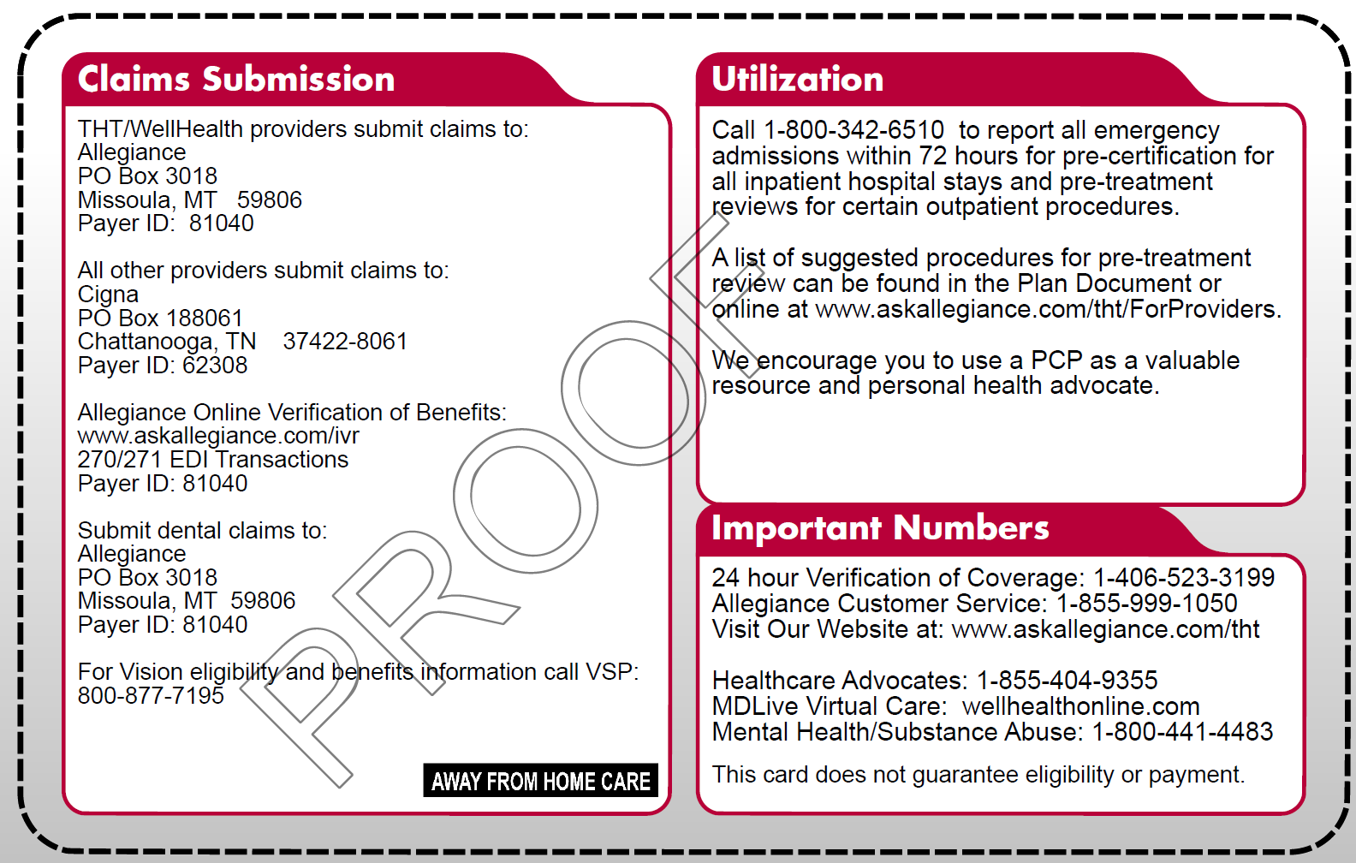
New Member Identification Cards
Sample ID Card (back)

